Slide 1
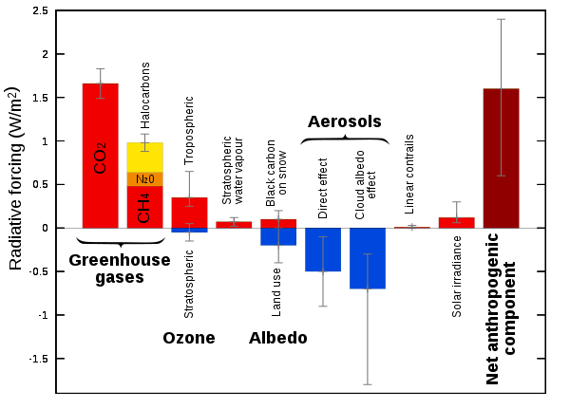
Leveling the playing field: expressing forcings in terms of $\frac{W}{m^{2}}$
Forcings of GHGs are all positive, of course. CO₂ is a very long-lived forcing (it stays in the atmosphere for 100s of years).
So far, the albedo effects have been negative! They’ve been protecting the planet from overheating. Unfortunately, those are all short-lived (a few years) hence Hansen’s Faustian Bargain.
Either way, the long-term effects of these forcings should be understood in the context of tipping points.

